Slide 1
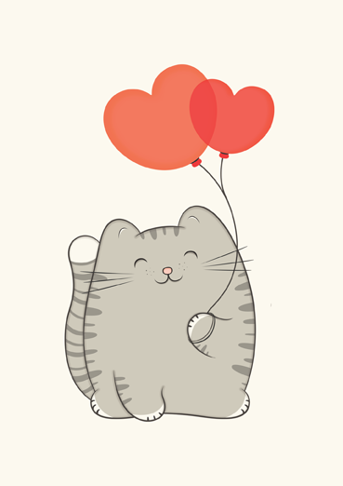

Slide 2

To me, you’re my purrrrrrrfect

Slide 3
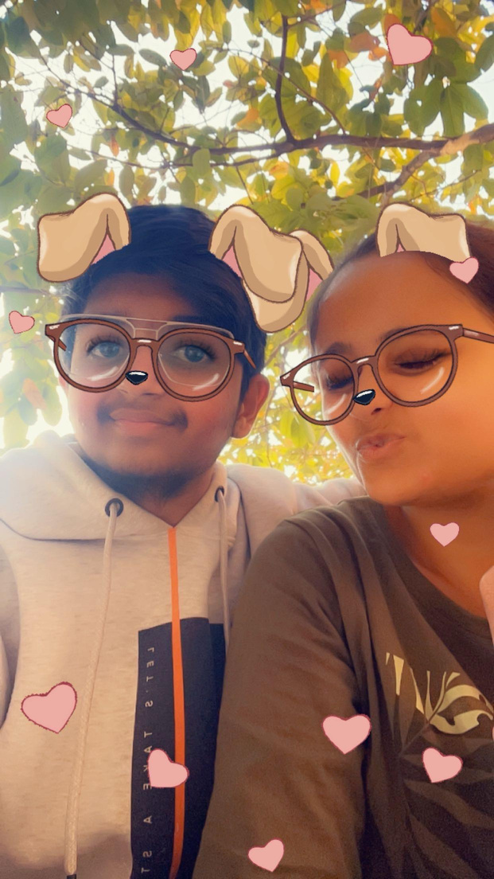


Slide 4


I love you the most, my cutie little princess. I want to be with you forever, no matter the situation, whether it's the worst or the best. All I want is you, and nothing more. I have imagined the most beautiful life with you as my life partner, a life beyond anyone's dreams.
I LOVE YOU

